Slide 1

Ubiquitous Computing
Smart Traffic Management

Slide 2
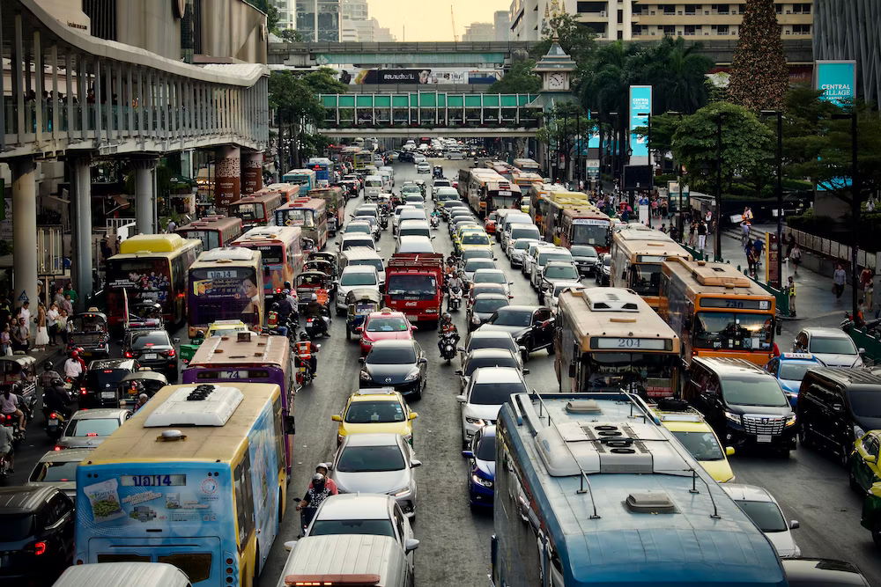
Introduction
We are addressing the growing pressures on the city's resources, transport networks, and logistic infrastructure.
Traffic jams, long commutes, noise, and pollution have become major blights in urban life. As the global population grows and becomes increasingly urbanized, these problems are likely to escalate. Already, 56 percent of the world’s population lives in cities; by 2050, nearly seven in ten people will do so.
We aim to leverage technology to manage transportation and reduce congestion, enhance urban life, protect neighborhoods, and improve quality of life.

Slide 3
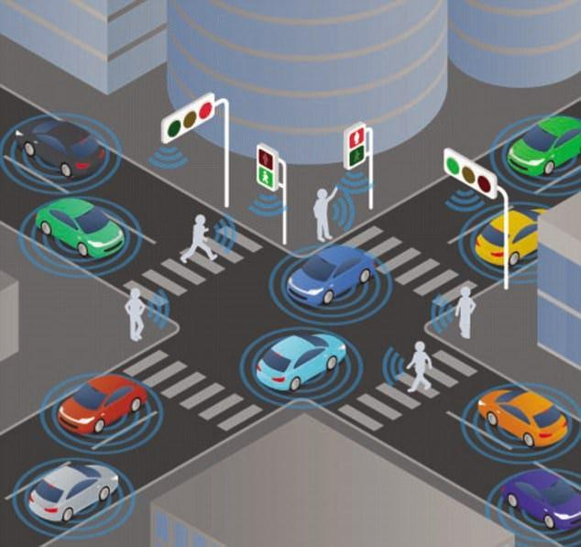
Aim
After the market research and understanding the difficulties caused due to traffic congestion, we noticed through the data that the major causes of traffic jams are the traffic signal junctions, if we can solve the traffic at junctions we will be able to reduce the traffic congestion.
In the signals present at junctions we noticed a major problem, the traffic signals were not smart enough to keep the traffic flow smooth.
Hence we came up with an idea of making the signals smart by predicting the amount of traffic at different times of the day so that accordingly we can turn the signals green/red for a specific time.

Slide 4
Problems
Often, the reason first responders cannot get patients to a hospital in time is because of traffic jams. In 2017, 20% of emergency patients' deaths were caused by traffic jams.
Heavy traffic congestion increases traffic flow and thus produces more O3 precursor emissions, leading to more adverse air quality issues.
According to the Central Pollution Control Board (CPCB), many Indian cities routinely experience daytime noise levels exceeding to 85 decibels with the permissible limit being 70 decibels.
On average 120 man-hours per year are lost per person in the metropolitan cities of India.
The socio-economic loss due to traffic woes in the year 2019 was estimated to be around Rs 20,000 crore, which is approximately 0.55% to 1.35% of India's GDP.

Slide 5
Market Research
Some of the specific ways in which poor signal timings can contribute to traffic congestion include:
Increased vehicle idling: When signals are not timed correctly, vehicles often have to wait longer for red lights. This can lead to increased idling, which wastes fuel and contributes to air pollution.
Stop-and-go traffic: Poor signal timings can also lead to stop-and-go traffic. This is when vehicles have to repeatedly accelerate and decelerate as they approach and depart from intersections. Stop-and-go traffic is less efficient than steady-flowing traffic, and it can also lead to increased fuel consumption and emissions.
Increased queue lengths: When signals are not timed correctly, queues of vehicles can build up at intersections. This can block other intersections and cause congestion to spread to other areas of the road network.

Slide 6
Market Research
Here are some more specific numbers and percentages on the effect of poor signal timings on traffic congestion:
According to the Federal Highway Administration (FHWA), poor signal timing can contribute to as much as 50% of traffic congestion in urban areas.
A study by the Texas Transportation Institute found that improving signal timings can reduce vehicle delays by up to 15% and travel times by up to 10%.
Here are some specific examples of how improving signal timings has reduced traffic congestion in different cities:
In Los Angeles, California, a city-wide effort to improve signal timing reduced vehicle delays by 10% and travel times by 7%.
In New York City, New York, a program to coordinate signal timing at major intersections reduced vehicle delays by 15% and travel times by 10%.
In London, England, a program to improve signal timing on a busy corridor reduced vehicle delays by 20% and travel times by 15%.

Slide 7
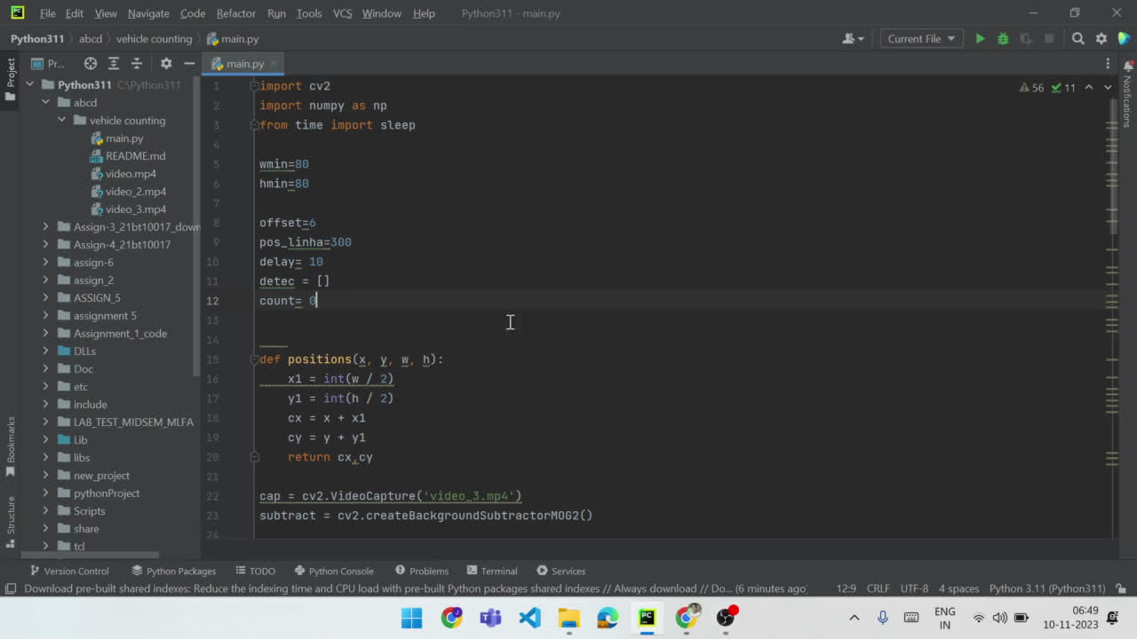
Demonstration for Vehicle Detection

Slide 8
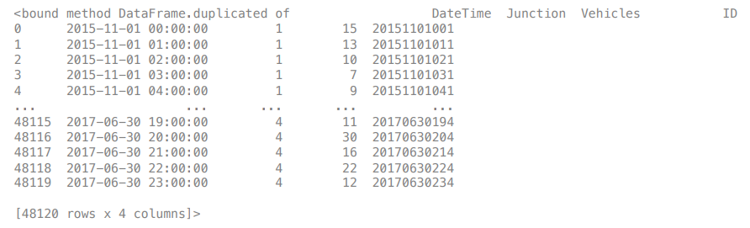
Raw DataSet
We collected the raw dataset from an very old website of Ministry of road transport US.
The data given is stated from 1st Nov, 2015 to 30th Jun, 2017.

Slide 9
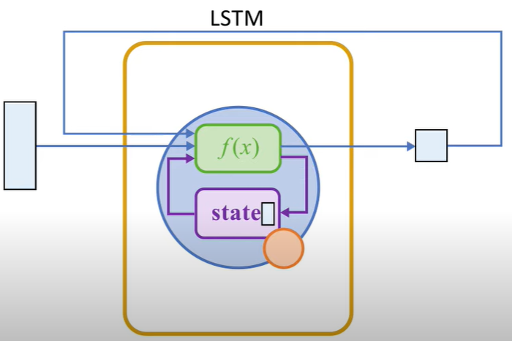
LSTM Model (long short term memory)
LSTM, or Long Short-Term Memory model network is a recurrent neural network (RNN) used for understanding and predicting things that happen in order. What sets LSTMs apart is their ability to remember important details for a long time and forget things that are less important.
Adam is an optimization algorithm that can be used instead of the classical stochastic gradient descent procedure to update network weights iterative based in training data.

Slide 10
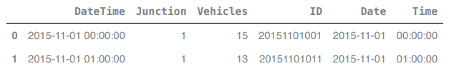
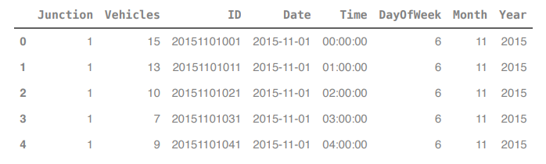
Steps for Preprocessing of Data
1] Separated Date and Time Columns
2] Created different columns of Week day, Month and Year

Slide 11
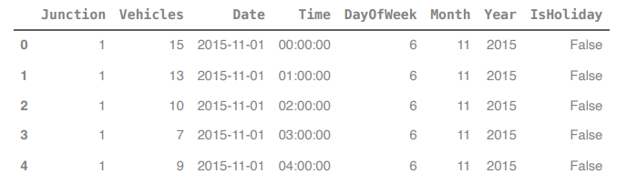
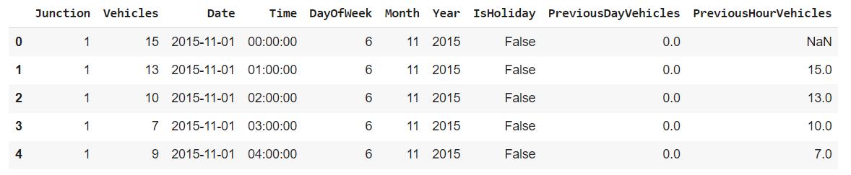
3] Removed useless column (ID) and Added a column for whether the given day is a holiday or not (Sundays included)
4] Recent Data also added in the column

Slide 12
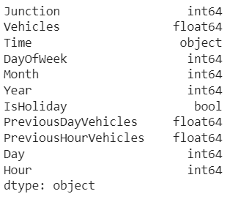
Optimized Data
All variables include:
Separated attributes from raw data
Added attributes for better preditction

Slide 13
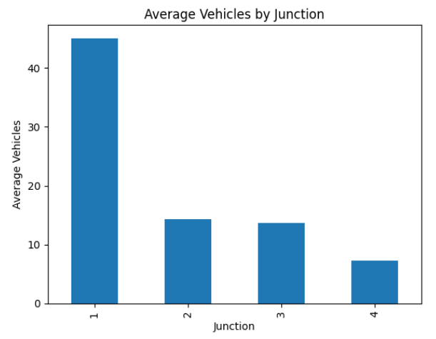
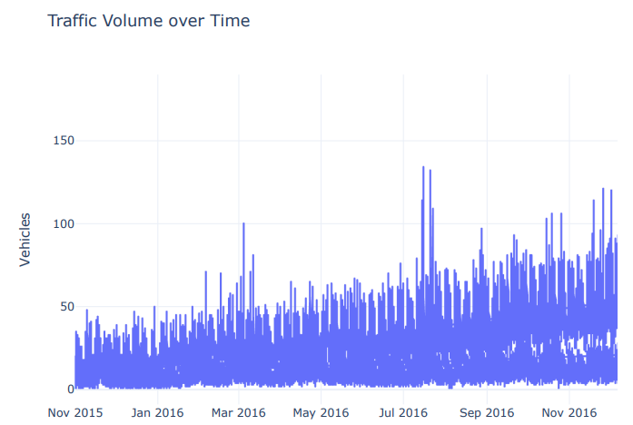
Important Graphs

Slide 14
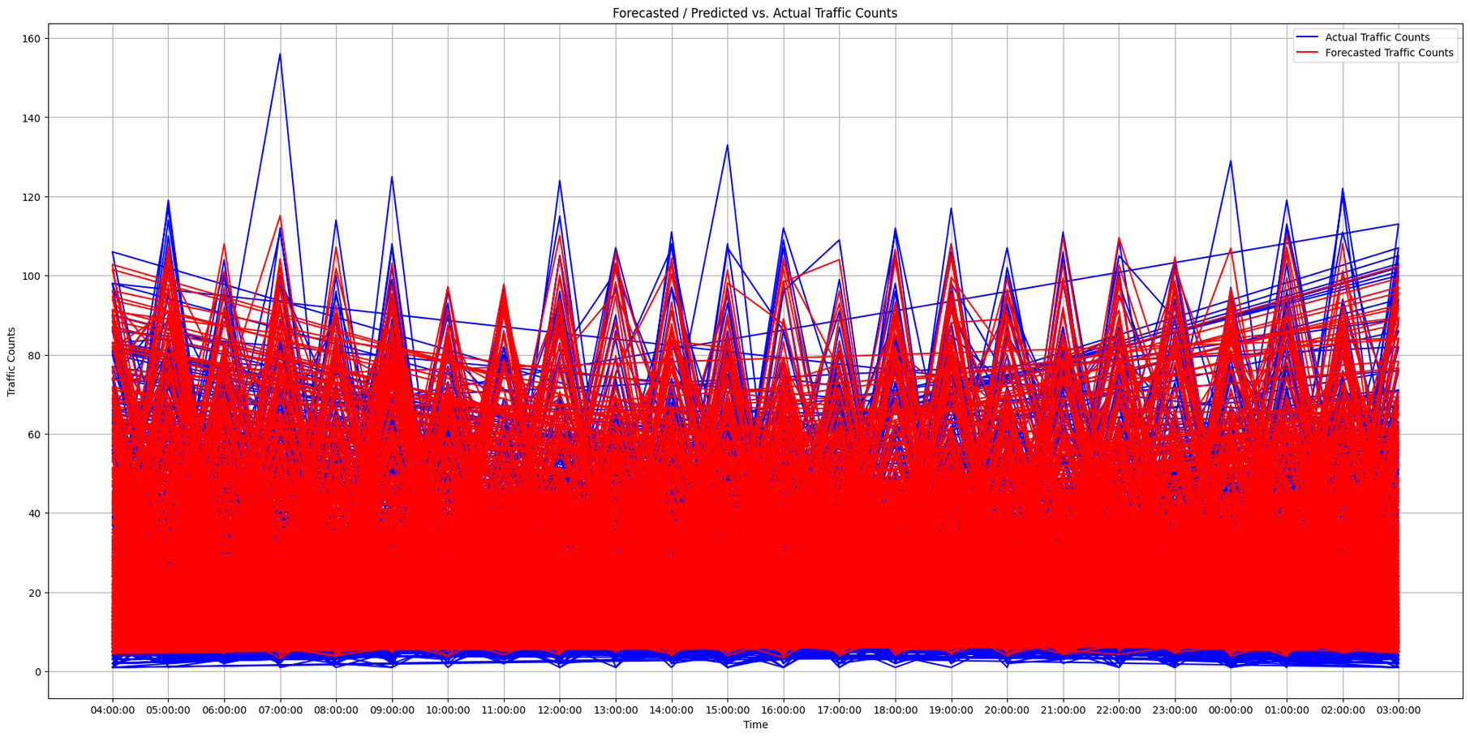
Predicted Outcomes
Blue Line: Actual Traffic Counts
Red Line: Forecasted Traffic Counts
This model provides 95% accuracy.

Slide 15

Time division in Traffic Signal
T
Current total time of 4 signals X no. of vehicles in junction i
i
Total number of vehicles in all junctions
*Here the number of vehicles is the predicted values

Slide 16
Problems and Challenges
Difficulty sourcing a relevant dataset for the model requiring vehicle count, junction number, date, and time, despite searching various websites.
Real time interaction was not possible despite developing a real time solution as it was not feasible.

Slide 17
Thank You

